Slide 1
Rockbuster Stealth LLC Data Analytics Project
Nastaran Barandish

Slide 2
Introduction
Rockbuster Stealth LLC, a global movie rental company, has long operated on a store-based rental model. However, with the rise of competitors like Netflix and Amazon Prime, the company faces significant challenges in maintaining its market share. To adapt and stay competitive, Rockbuster's management plans to leverage its extensive movie inventory to launch an online video rental service.
This project aims to analyze Rockbuster's payment, film inventory, and customer data to uncover insights that will shape its 2020 strategy for entering the online rental space. By answering key questions—such as which movies generate the most revenue or where the high-value customers are located—this analysis provides actionable recommendations for a successful transition to the digital market

Slide 3
Objective & Key Questions
Objective:
Analyze Rockbuster's payment, film inventory, and customer data to uncover valuable insights that will guide the company's transition to an online video rental service in 2020. The goal is to understand customer behavior, revenue trends, and geographic opportunities to create an effective digital expansion strategy.
Key Questions
Which movies generated the highest and lowest revenue?
What are the top 10 countries with the highest customer base?
Which cities are home to Rockbuster's top customers?
Who are the top 5 customers, and what is their contribution to revenue?
How do revenues differ across countries and regions?

Slide 4

Total Revenue Overview
The total revenue generated by Rockbuster Stealth LLC across all movies, customers, and regions amounts to $61,312.04. This figure serves as a baseline for analyzing the contributions of high and low-performing movies, top customers, and revenue distribution by country and region. It highlights the company's current performance and lays the groundwork for identifying key opportunities to enhance growth through its online expansion.

Slide 5

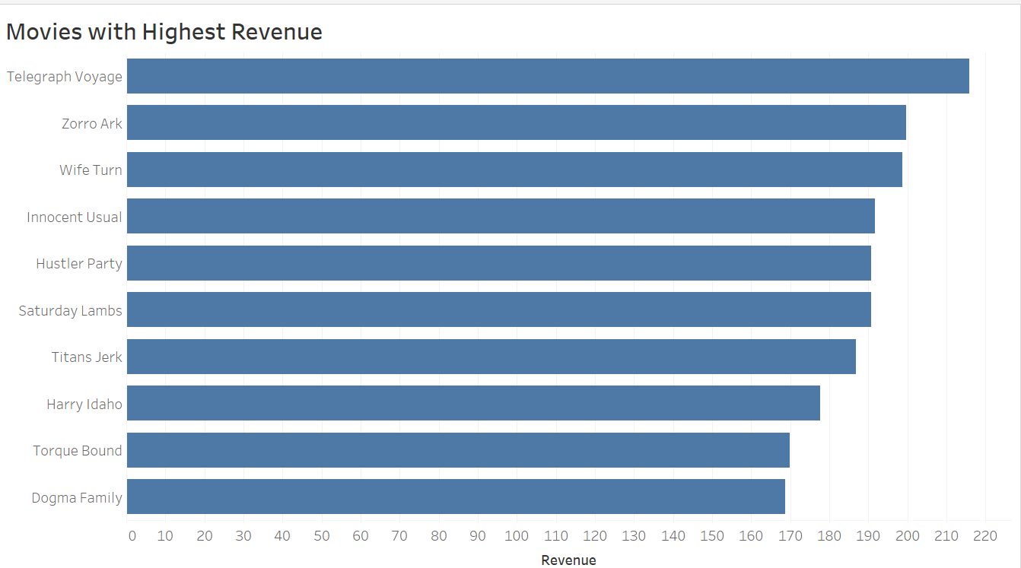
Top 10 High-Revenue Movies
The first visualization highlights the top 10 movies that generated the highest revenue for Rockbuster. These movies represent the most popular titles in the company's inventory, showcasing customer preferences and high-demand films. By focusing on these titles, Rockbuster can identify key trends in genre or audience appeal to inform future strategies.

Slide 6
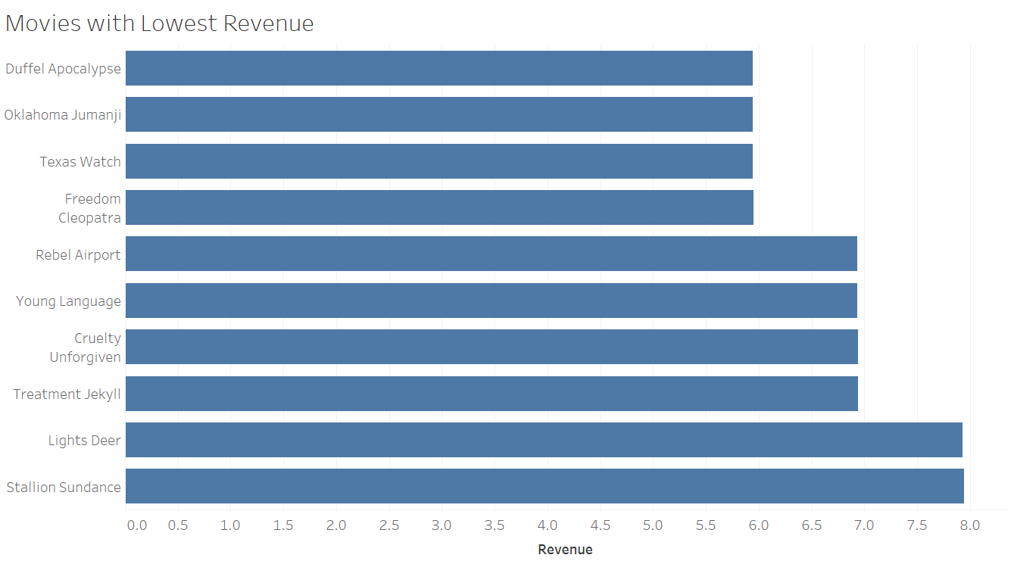
Movies with Lowest Revenue
The second visualization highlights the ten movies that contributed the least to Rockbuster's revenue. These movies represent the least-rented titles in the inventory, offering insights into customer preferences and identifying underperforming content. Such information can help Rockbuster decide which movies to promote differently or consider for future content adjustments.

Slide 7
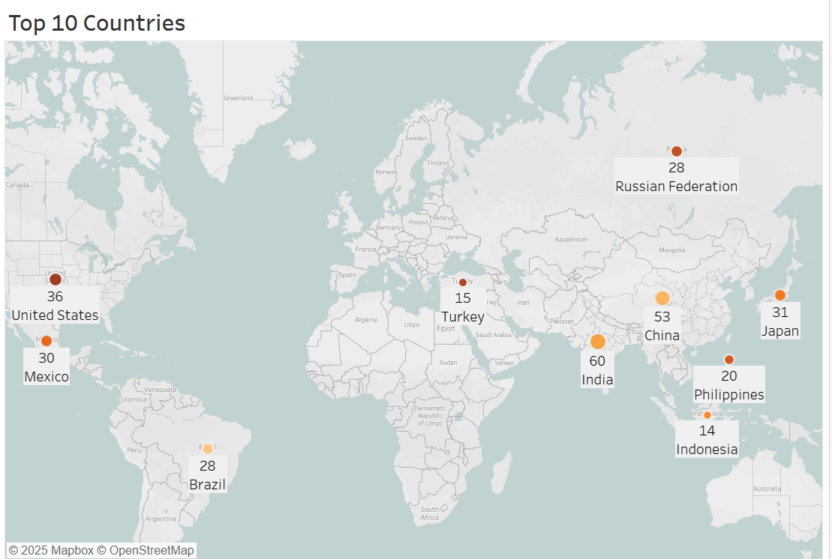
Top 10 Countries
This visualization is a world map showing the top 10 countries where Rockbuster's customers are based. The highlighted countries include major markets across Asia, North America, and other regions, reflecting a diverse customer base. Among these countries, India and China stand out, with Asia emerging as a significant contributor to the company's customer base. This geographic distribution provides valuable insights for shaping Rockbuster's online expansion strategies.

Slide 8
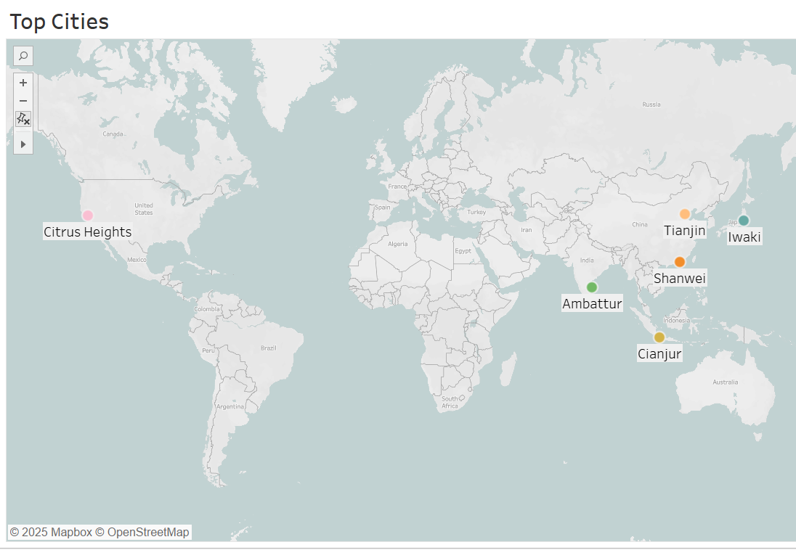
Top Cities by Customer Base
This visualization highlights the top cities where Rockbuster's high-value customers are located. These cities are spread across the top 10 countries and represent significant opportunities for targeted marketing efforts. Notably, some of these cities are in Asia, reflecting the region's strong presence in Rockbuster's customer base. This data can guide localization strategies for online expansion.

Slide 9
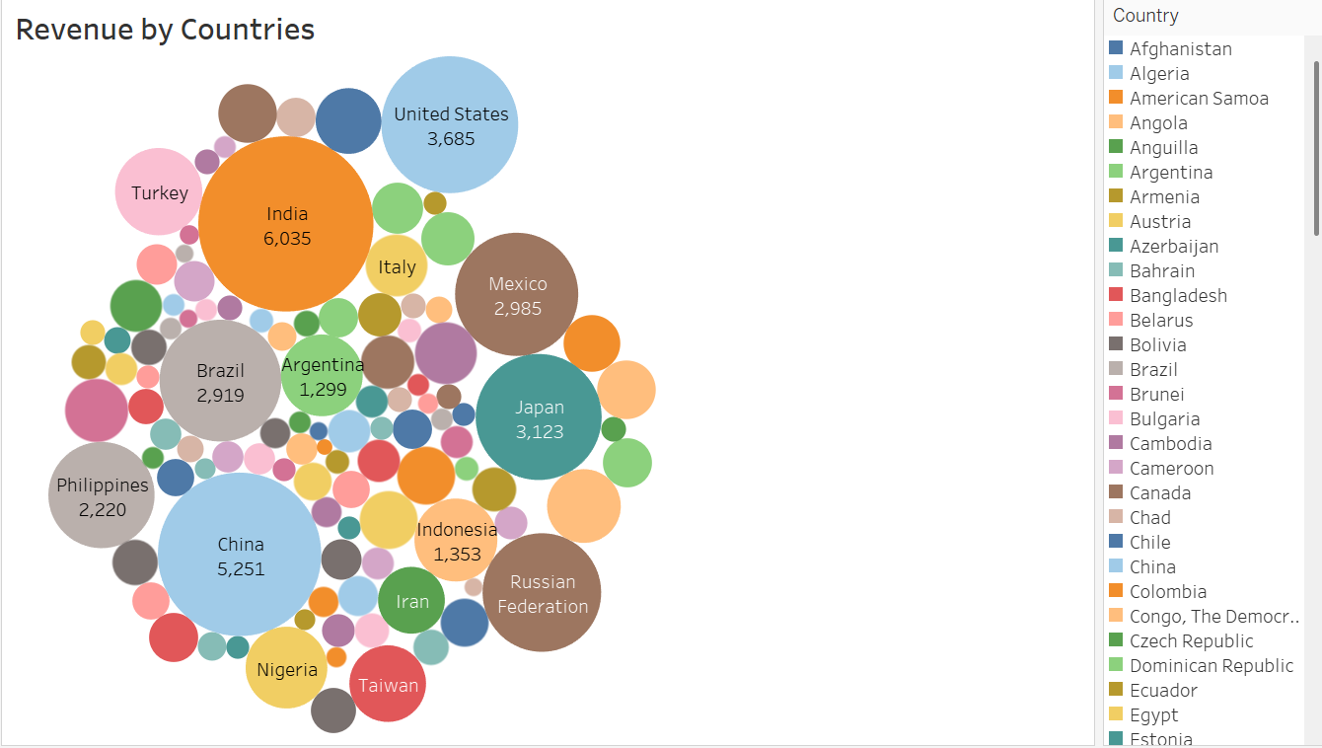
Revenue by Countries
This visualization showcases the revenue generated by different countries using bubbles of various sizes. Larger bubbles represent countries with higher revenue contributions, while smaller bubbles indicate lower revenue. It highlights the significant role that countries like India, China, and the United States play in Rockbuster's overall revenue, with Asia emerging as a dominant region. This visualization emphasizes the importance of focusing marketing efforts in high-revenue countries to support the company's digital expansion strategy.

Slide 10
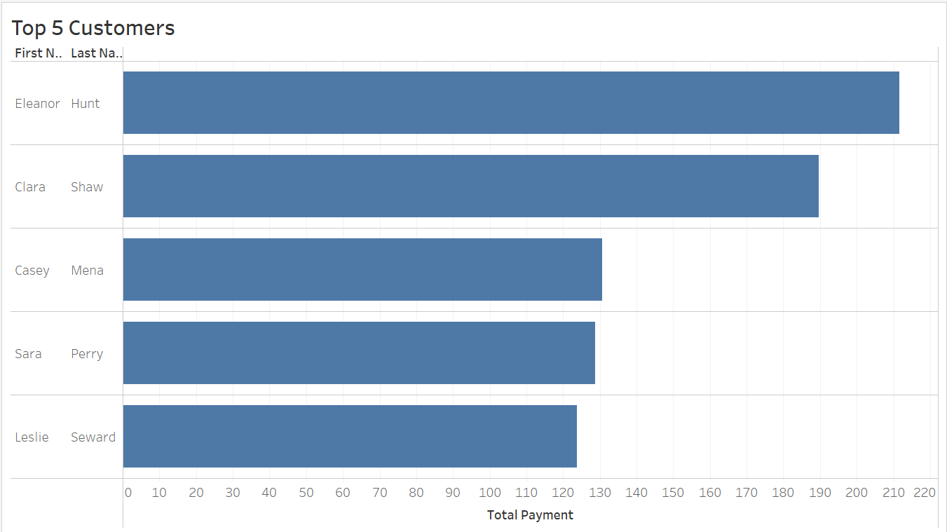
Top 5 Customers
The sixth visualization is a horizontal bar chart that displays Rockbuster's top 5 customers ranked by the total payments they have made. These high-value customers are distributed across different cities and represent a crucial segment for understanding customer loyalty and spending behavior. This data can help Rockbuster tailor special promotions or loyalty programs for its most valuable clients, supporting customer retention and increased revenue generation.

Slide 11
Key Findings
The top 10 movies accounted for only 3.1% of Rockbuster’s total revenue, indicating revenue is distributed across many movies.
The average rental duration for all movies is five days, with a range of three to seven days.
Six of the top 10 countries where customers reside are in Asia, with India and China as key markets.
Two of the top five high-value customers are based in Asia, reflecting the region's significant contribution.
Asia generated the highest sales among all regions, contributing 43.5% of Rockbuster's total revenue

Slide 12

Conclusion & Recommendation
Conclusion: Rockbuster Stealth LLC has a unique opportunity to leverage its existing movie inventory and customer insights to compete effectively in the online video rental market. The data reveals that Asia is a crucial market, with high revenue generation and a significant customer base. By optimizing rental durations, targeting marketing efforts, and localizing the movie catalog, Rockbuster can establish a strong foothold in the digital rental space and drive growth in the competitive landscape.
Recommendations:
Conduct further analysis by stratifying movie rental data by rental rates and lengths to identify additional revenue opportunities.
Set online rental durations between three and seven days, aligning with current rental patterns.
Focus marketing efforts in Asia to target its large customer base and maximize revenue potential.
Expand the movie catalog to include more films in Asian languages, catering to the preferences of the dominant market

